Slide 1
Tables dependencies resolution
You can tell dbt which tables you want to build and it will automatically build all the other tables on which this table is dependent in a correct order and it will make sure that none table is built twice.
We can run a single command saying ‘build all tables’ and dbt will build all the tables in a correct order, without building any table twice.
For example let’s say that table2 and table3 are both dependent on table1. dbt helps us avoiding problems such as:
We build table2 while table1 has not been built yet.
We build table1 and table2, and after that we build table1 and table3. The table1 has been built twice.
Problem2: We build table1 twice, in two processes. One process is building table2, second one is building table3.
Correct order of building:
Problem1: We build table2 without building table1
table1
table1
table1
table2
table2
table3
table2
table3
Process 1
Process 2

Slide 2
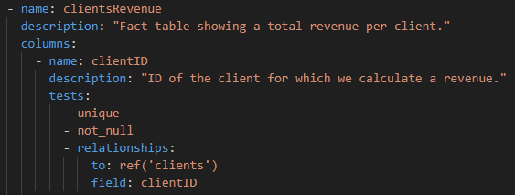
Data quality tests
In dbt we are creating YAML files in which we can specify data quality tests. For example on the below example we are checking if ClientID satisfies the following checks:
Values are unique
There are no null values
Every value have corresponding value in the ‘clients’ table (as it is a foreign key).

Slide 3
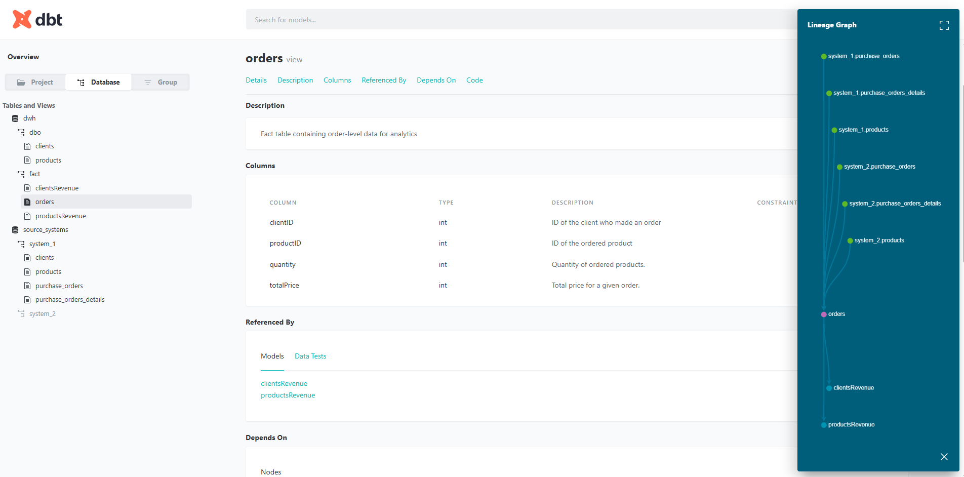
Data documentation
dbt generates a website with data documentation like it is shown below. Tables and columns descriptions are defined in YAML files like it is shown in the previous slide.

Slide 4
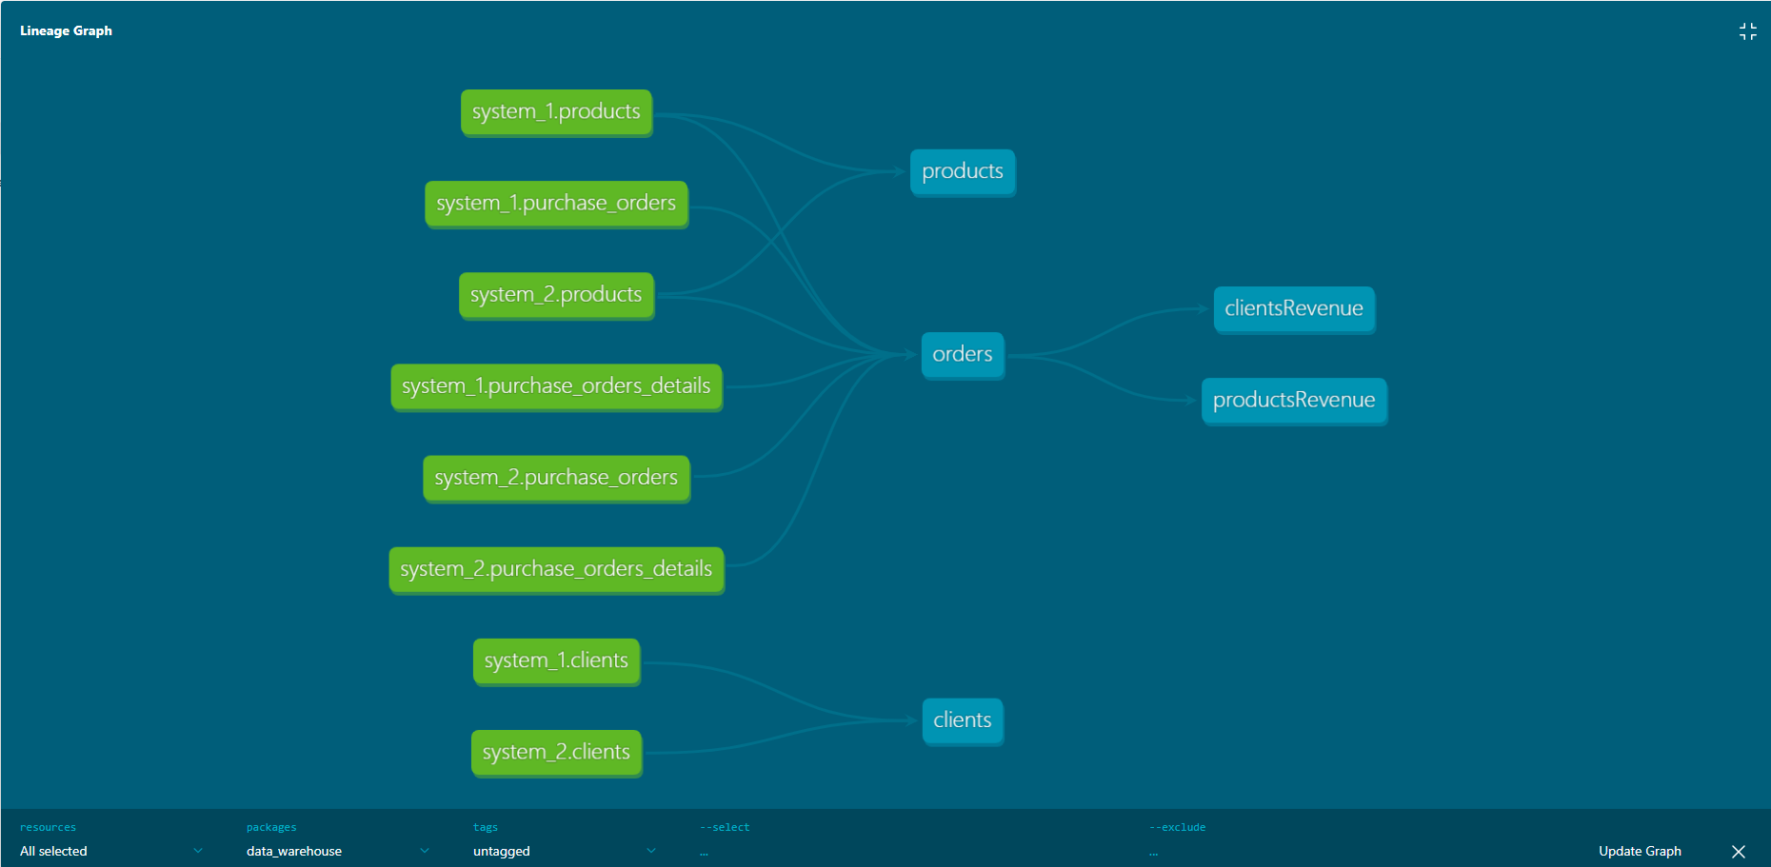
Data documentation
dbt generates a website with data documentation like it is shown below.

Slide 5
x
x

